Slide 1

STREAM GROUP
DISCRIMINATORY HARASSMENT
TRAINING
Consultants to Management
Akron | Cincinnati | Columbus | Lima
1.800.282.0787
www.clemansnelson.com
209391.pptx
© 2024 Clemans, Nelson & Associates, Inc.

Slide 2
The Scope of Today’s Training
Why we have a policy
  State & federal law
  Policy goals
What the policy prohibits & requires
  Coworkers
  Supervisors
  Case Study—Amie Morningstar v. Circleville Fire (2018)
Proactive, collaborative strategies for addressing problematic behavior
© 2024 Clemans, Nelson & Associates, Inc.

Slide 3
The Scope of the Problem
Workplace misconduct, including but not limited to discriminatory harassment threatens organizations’ ability to carry out their missions.
The “cost of harassment includes detrimental organizational effects such as decreased workplace performance and productivity, increased employee turnover, and reputational harm.”
Employees who behave badly. Examples of the worst:
  Sexually predatory/harassing behavior
  Assault
  Hostile acts that relate to a person’s race, color, religion, gender, national origin, age, or disability
© 2024 Clemans, Nelson & Associates, Inc.

Slide 4
The Scope of the Problem
Excuses of Harassers:
  It’s just stress relief
  Everyone talks that way (goes to multiple protected classes)
  I’m just a “touching” person
  I’m just like that and everybody accepts it
  What about so-and-so? You should hear them!
  I didn’t mean it; you’re making too much of this
© 2024 Clemans, Nelson & Associates, Inc.

Slide 5

Discrimination v. Harassment
DISCRIMINATION
Material employment decisions motivated by animus against an individual’s protected class in
  Hiring
  Firing
  Promotion/Demotion
  Terms and Conditions of Employment
  Discipline
Hostile work environment:
  Offensive & unwelcome conduct directed at an employee which is motivated by animus against the employee’s protected class
Quid Pro Quo:
  Conditioning terms and conditions of employment on submission to sexual activity of any kind
© 2024 Clemans, Nelson & Associates, Inc.

Slide 6
Harassment
Harassment – term is often used loosely; means to trouble, worry, or torment someone on a persistent basis
Forms of Harassment:
  Verbal – includes things said, written, or inappropriate sounds
  Physical – includes hitting, pushing, blocking someone’s way, inappropriate touching
  Visual – includes calendars, pictures, any inappropriate object that can clearly be seen
© 2024 Clemans, Nelson & Associates, Inc.

Slide 7
Discrimination
Discrimination – occurs when a person or group of people are treated differently from another person or group of people. Title VII of the Civil Rights Act of 1964 prohibits discrimination on the basis of race, sex, religion, national origin, and color. Other federal laws prohibit discrimination on the basis of age, disability, pregnancy and genetic information. These different classifications of people are considered “protected classifications.”
© 2024 Clemans, Nelson & Associates, Inc.

Slide 8
Discriminatory Harassment
Discriminatory harassment therefore occurs only when a person is troubled, worried, or tormented on a persistent basis because of his or her status in a protected classification in violation of the law.
There is a difference between inappropriate conduct for the workplace and unlawful discriminatory harassment.
© 2024 Clemans, Nelson & Associates, Inc.

Slide 9
SOURCES OF LAW
Federal
  §703 of Title VII of Civil Rights Act of 1964
  EEOC guidelines in Chapter 29, section 1604.11 of the Code of Federal Regulations
  Affirmative Action Plan (29 Code Fed. Reg. sec. 1608.)
Ohio courts generally mirror federal courts on discrimination laws
Punitive Damages: Employers may be held vicariously liable (i.e., liable for actions of managerial agents)
© 2024 Clemans, Nelson & Associates, Inc.
Notes:
We are going to talk mostly about sexual harassment because this is the most common type of offense and there is more research on this type of harassment than any other form; however, these guidelines apply to any form of illegal discriminatory harassment.

Slide 10
What is Sexual Harassment?
Two general types
  Quid pro quo
    Occurs when someone in a supervisory position “relies upon his apparent or actual authority to extort sexual consideration from an employee”
  Hostile environment
    “[w]hen the workplace is permeated with discriminatory intimidation, ridicule, and insult that is sufficiently severe or pervasive to alter the conditions of the victim’s employment and create an abusive working environment.”
© 2024 Clemans, Nelson & Associates, Inc.
Notes:
Quid pro quo: employee gives sex (or sex-related) for promotion, raise, job retention, etc.

Slide 11
Hostile Environment
Unwelcome conduct can take on many forms, including:
  Sexual Advances - Unwelcome advances of the type found in quid pro quo cases are equally applicable to hostile environment cases, even where there is no tangible job action taken.
  Gender Hazing - Often physical in nature and can be hate motivated or merely involve sex‑based practical jokes that often result in damage to work equipment or personal property.
  Gender Baiting - Generally non‑physical, involving gender‑based barbed comments, or generalizations about an entire gender.
© 2024 Clemans, Nelson & Associates, Inc.

Slide 12
Hostile Environment
Sexually-Charged Atmosphere: An atmosphere in which sex-based discussion and conduct are prevalent
  Employees discussing details of romantic relationships
  Employees bragging about sex lives and "conquests,” real or imagined
  Pornographic or suggestive material kept or posted in the workplace
  Off-color jokes and double-entendres
  Overly persistent date seekers in the workplace
  Graffiti, t-shirt art, off-color birthday cards, "girlie" calendars, etc.
© 2023 Clemans, Nelson & Associates, Inc.

Slide 13
DISCRIMINATORY HARASSMENT -
OTHER PROTECTED CLASSES
Racial and/or Religious Harassment
Age/ADEA Harassment: no circuit has, as yet, applied the hostile-environment doctrine in an ADEA action, but such a theory is likely viable under the ADEA
ADA/Disability Harassment
  Pregnancy Discrimination/Maternity Leave: Discrimination based upon pregnancy, childbirth, or other related medical conditions are illegal under the Pregnancy Discrimination Act (PDA)
© 2023 Clemans, Nelson & Associates, Inc.

Slide 14
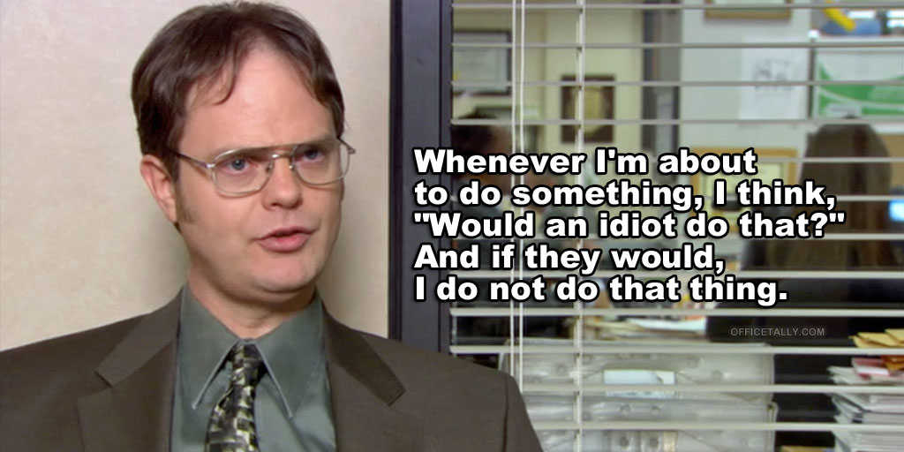
Helpful Tip From Dwight Schrute
© 2024 Clemans, Nelson & Associates, Inc.

Slide 15
Case Study: Amie Morningstar v. Circleville Fire et al, S.D. Ohio 2018
Plaintiff: First female firefighter at CFD, started 2003
Count 1: Discrimination Issues
  Passed agility test but did not receive equipment for 4 years, could not go on runs (males received equipment in 2-4 mos)
  Increased difficulty of agility test right before she took it, testimony that elements on the agility test were never required in the field (she passed anyway)
  In 2007, after she passed the test, Captain wrote in a report: “Unfortunately it is time to allow a female into the department.”
  Only employee in history required to undergo 90-day probationary period (30 days was standard)
  Lt Test: Chief told her no point in testing because she would not pass, called her a bitch in front of agency doing the test
Judgment: $3.25m compensatory; $100k punitive against Chief personally; $500k in attorney fees
© 2024 Clemans, Nelson & Associates, Inc.

Slide 16
Amie Morningstar v. Circleville Fire et al, S.D. Ohio 2018
Count 2: Harassment (Gender Bias) Issues
  “Pranks” such as
    Ejaculating on her blankets
    Urinating in her shampoo bottles
    Cutting holes in her clothing
    Stealing her gloves, socks, radio & tampering with safety mask
  Response to pranks
    Memo: immediate termination if further tampering occurred
    Surprise of the day: sternly worded memos are often ineffective
      Behavior continues throughout the remainder of her career
      No one was disciplined/terminated
  Name calling
    Frequently referred to as “f****** bitch,” “c***,” “whore,” “slut”
© 2024 Clemans, Nelson & Associates, Inc.

Slide 17
Amie Morningstar v. Circleville Fire et al, S.D. Ohio 2018
Count 3: Harassment (Sexual Desire) Issues
  Sexual advances/administration response
    2014: another employee (who would later admit to this) grabbed her repeatedly and forcibly kissed her, and on one occasion put his head on her chest/breasts
    When she complained, nothing was done; Chief called her a “bitch” in the meeting regarding the complaint, told her not to talk about the complaint outside the department
    HR got involved, fired the Grabber, and Chief circulated a memo about his termination emphasizing the extra work load his departure caused
Failure to establish affirmative defense
City retains law firm for investigation
  Evidence did not establish violations of the City’s discrimination, harassment, and retaliation policies
© 2024 Clemans, Nelson & Associates, Inc.

Slide 18
Addressing common questions
Why didn’t she speak up?
  She did. Repeatedly. She was insulted when she did. Her complaints were determined to be baseless.
  She was placed on leave while the man that assaulted her continued to work.
Hit back?
  She did. It was (ineffectively) used against her at trial.
Quit and go somewhere else?
  “I grew up in Circleville. My father was terminally ill, my mom battled seizures, and my oldest son has a heart condition. Taking care of them was a huge part of my identity and life. So I realized that if I became a paramedic and firefighter in my community, it would let me not only provide financially for my family but also always be there if something happened. For me Circleville was my only option—serving my community and family and friends meant so much to me.”
© 2024 Clemans, Nelson & Associates, Inc.

Slide 19
Response Philosophy
Sexual harassment is a whole workplace problem.
Effects on the individual
  Depression
  Anxiety
  Link between harassment & PTSD
  Long term implications for employment prospects
Effects on the workplace
  Direct impact on profitability, productivity, efficacy
  Sick leave costs associated with harassment estimated to be in the billions of dollars
  Employee turnover → most expensive personnel cost
    Both victims and witnesses are more likely to leave
© 2024 Clemans, Nelson & Associates, Inc.

Slide 20
Bystander Intervention
Adopt the “See something, say something” model
Disrupt behavior before it escalates
Engage in professional, polite intervention
  Change the subject
  Approach the offender later
  Refocus on WORK
    If anything approaching harassment occurs, that means work is not.
  If someone stands up to the harasser, you’re on that person’s side
  Do it every time you hear it—whether the target is present or not.
© 2024 Clemans, Nelson & Associates, Inc.

Slide 21
What can I (employee/coworker) do?
Follow the policy manual and work rules.
Keep conduct professional.
Avoid workplace romances.
Respect Others:
  Recognize others as human beings and relate to them on the level of being human.
  Tolerate the differences of others.
Due to differences in perception, do not distribute humorous cartoons, jokes, birthday cards, etc.
Report workplace harassment – everyone is responsible and will be held accountable for failure to report (no retaliation for reporting)
© 2024 Clemans, Nelson & Associates, Inc.

Slide 22
IT’S A TEAM EFFORT
Positive Atmosphere
  Trust is critical to the success of teams
  Trust comes with team member honesty, dependability, and sincerity
Cooperative Relationships
  This is the main reason teams can be more successful than individuals
  A team is greater than the sum of its individuals
© 2024 Clemans, Nelson & Associates, Inc.

Slide 23

Questions?
1.800.282.0787
www.clemansnelson.com
Akron | Cincinnati | Columbus | Lima
© 2024 Clemans, Nelson & Associates, Inc.

